Slide 1
The Universal Gates
NAND and NOR

Slide 2


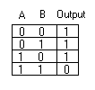

NAND Gate
“NOT AND”
==

Slide 3




NOR Gate
“NOT OR”
==

Slide 4

NAND Conversions
NAND as a NOT
(xx)’
(x)’ Idempotent
x’ Associative

Slide 5
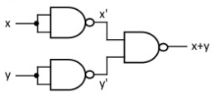
NAND Conversions
NAND as an OR
((xx)’(yy)’)’
(x’y’)’ Idempotent
x+y Demorgan’s

Slide 6

NAND Conversions
NAND as an AND
((xy)’(xy)’)’
((xy)’)’ Idempotent
(x’+y’)’ Demorgan’s
(xy) Demorgan’s
xy Assosiative

Slide 7

NOR Conversions
NOR as a NOT
(x+x)’
(x)’ Idempotent
x’ Associative

Slide 8
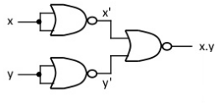
NOR Conversions
NOR as an AND
((x+x)’ + (y+y)’)’
(x’+ y’)’ Idempotent
xy Demorgan’s

Slide 9

NOR Conversions
NOR as an OR
((x+y)’ + (x+y)’)’
((x+y)’)’ Idempotent
(x’y’)’ Demorgan’s
(x+y) Demorgan’s
x+y Assosiative

Slide 10
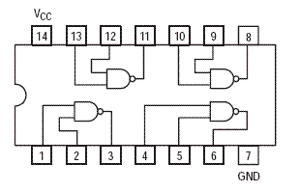
NAND
SN74LS00N

Slide 11
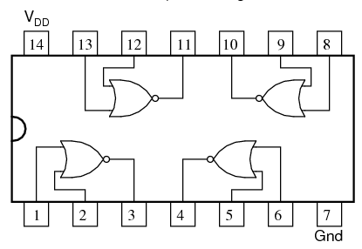
NOR
SN74LS02N

Slide 12
Complete the NAND and NOR Equivalence Assignment
File is on the HUB under IC Gates and Circuits → Labs and Assignments
Complete work using Logisim (Similar to Boolean algebra assignment)
When you’re finished, move on to the next slide.

Slide 13
Universal Birthday
In Logisim, convert your birthday circuit so that you only use NANDs
In the same Logisim file, convert your birthday circuit so that you only use NORs
Determine how many gates you will need to build each circuit (including your original birthday)
Determine how many chips you will need to build each circuit
You DO NOT have to physically build these new circuits.

